Slide 1


Slide 2

TECHNICAL SESSION Mentor: Ram kumar sir

Slide 3

Speaker
Name: JALARAM Employee Number:31 Position: SDE-I

Slide 4
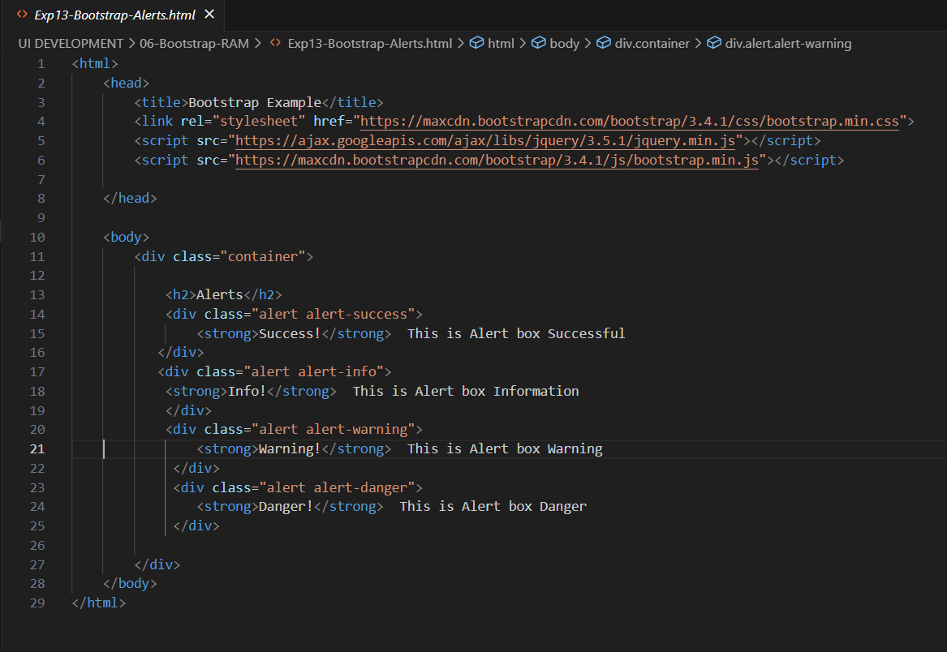
ALERTS

Slide 5
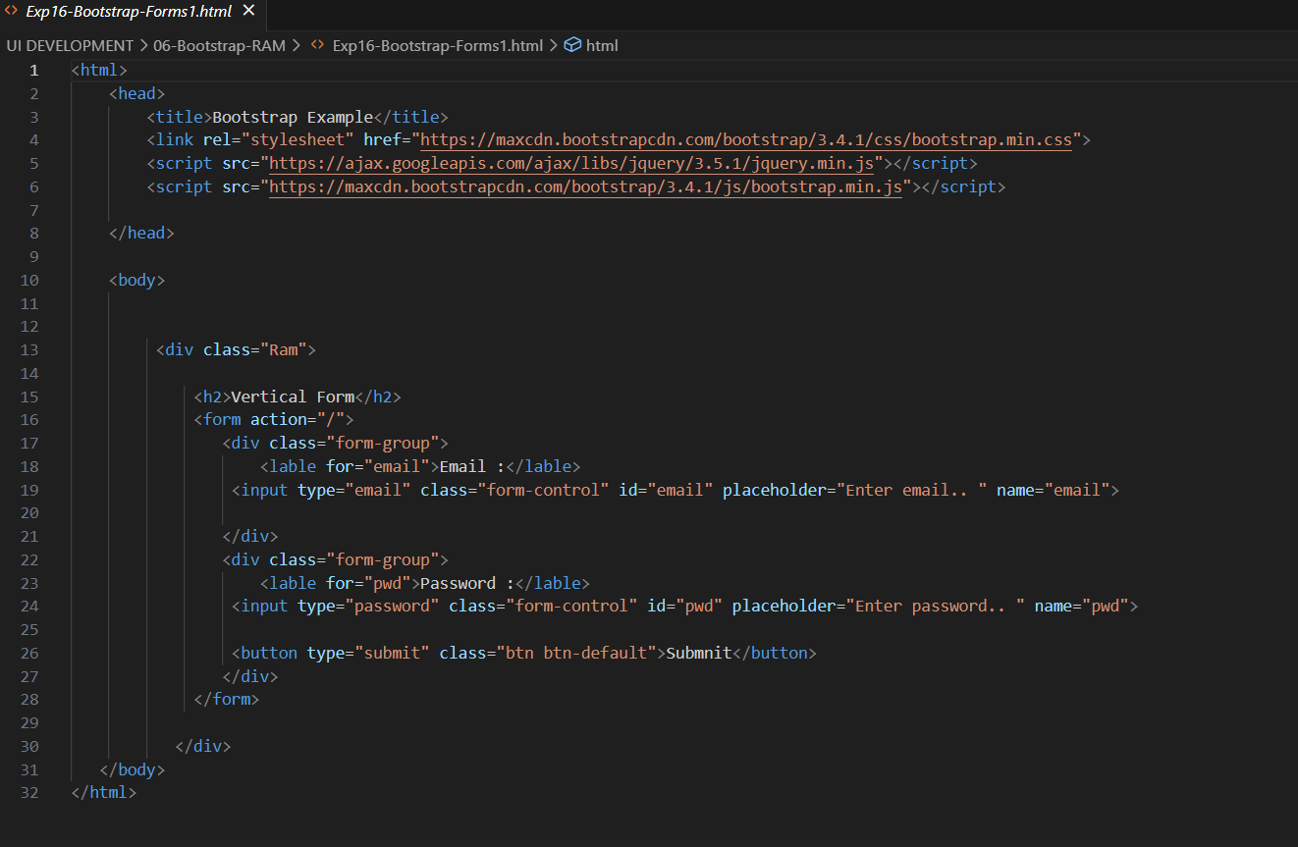

Slide 6
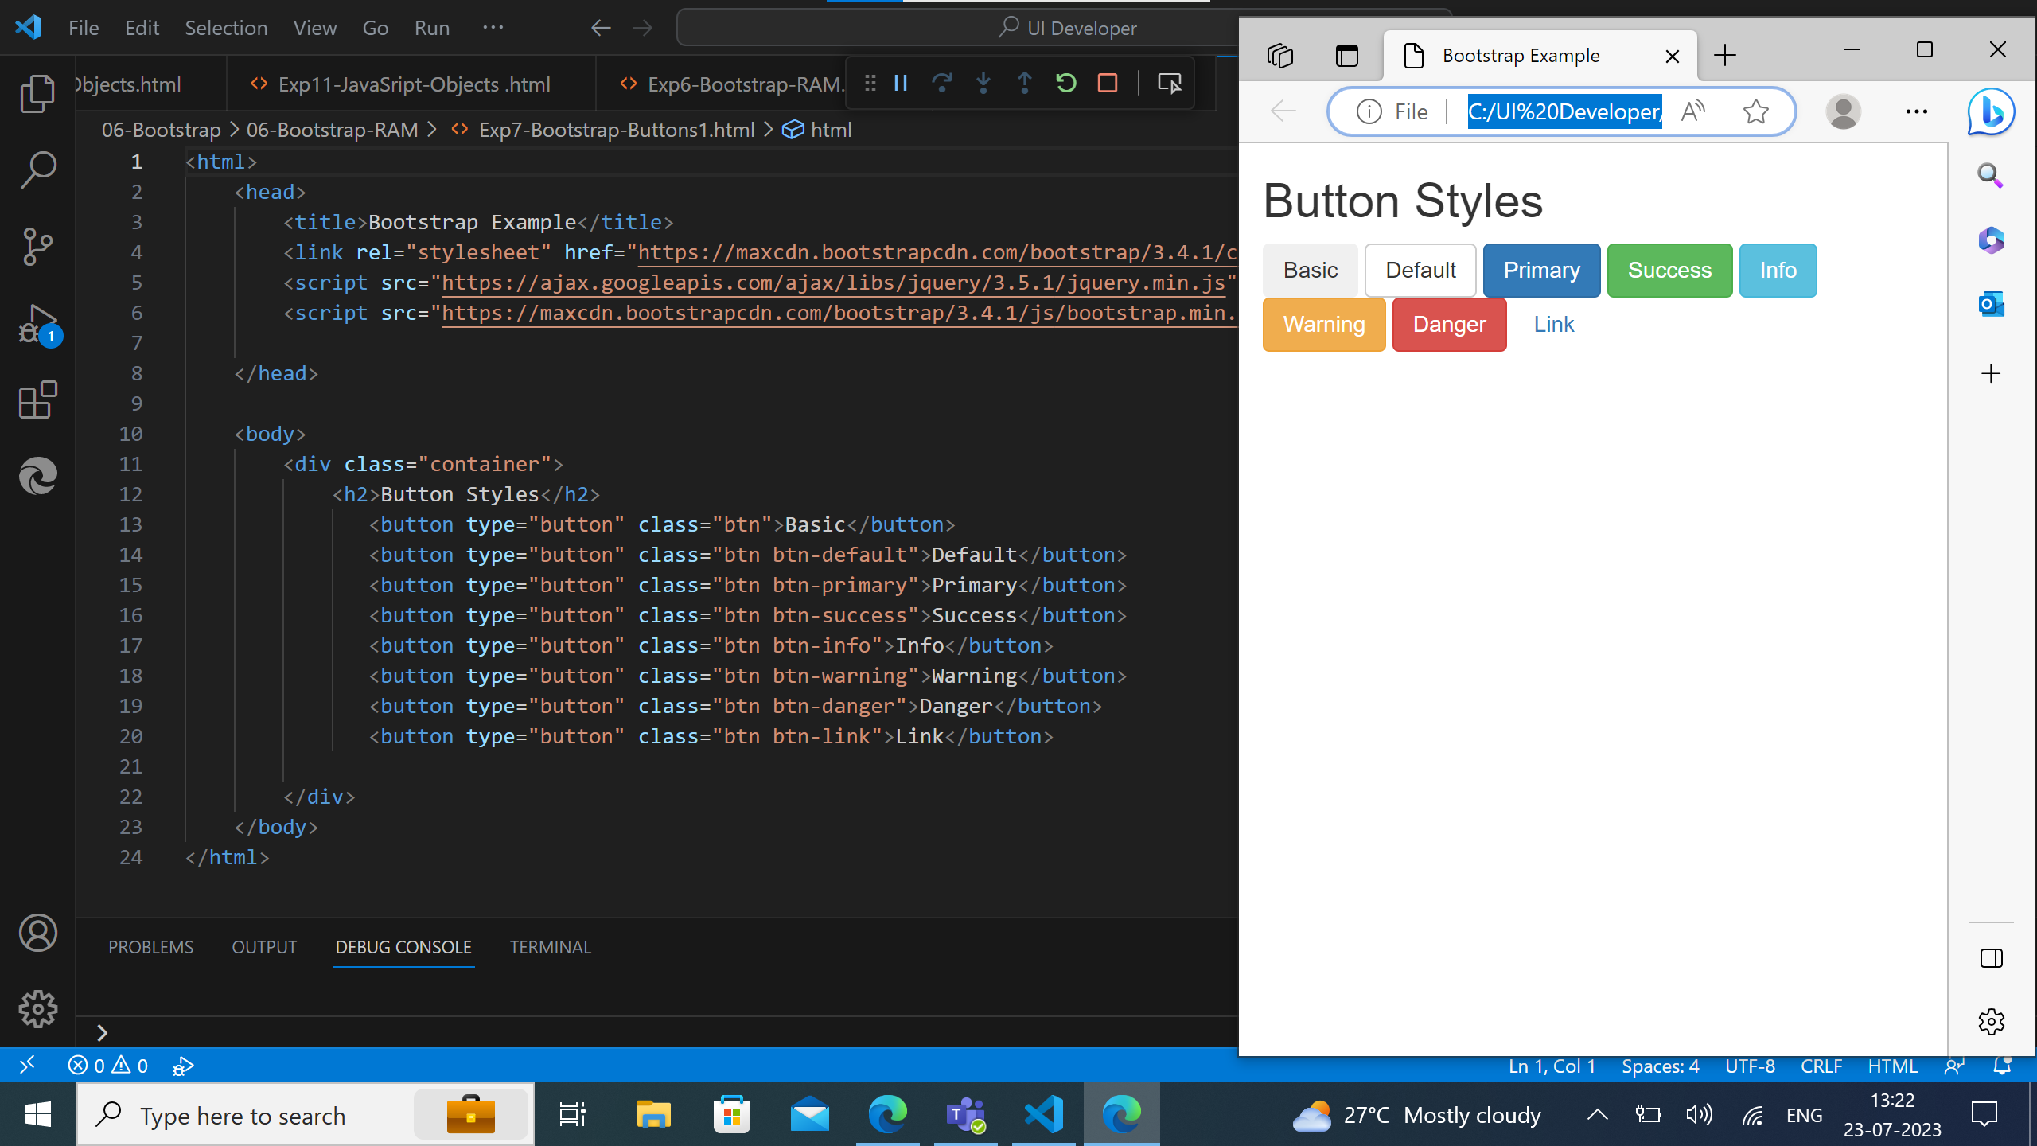

Slide 7
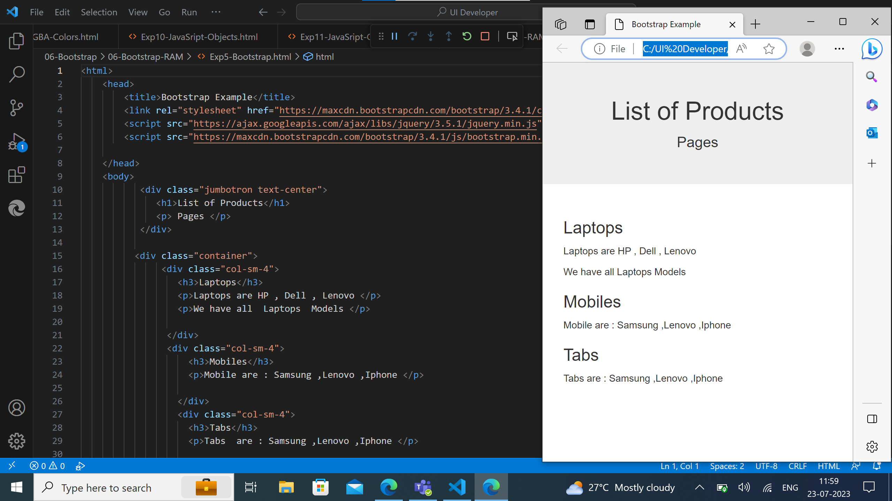

Slide 8
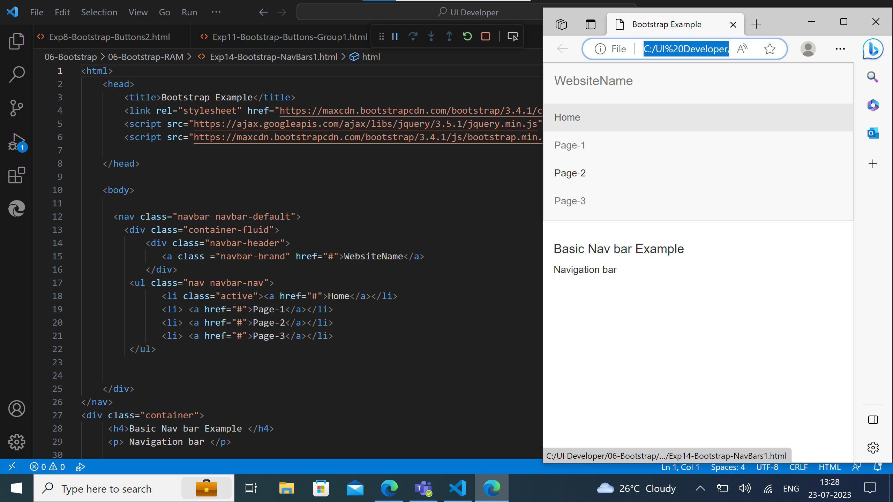

Slide 9
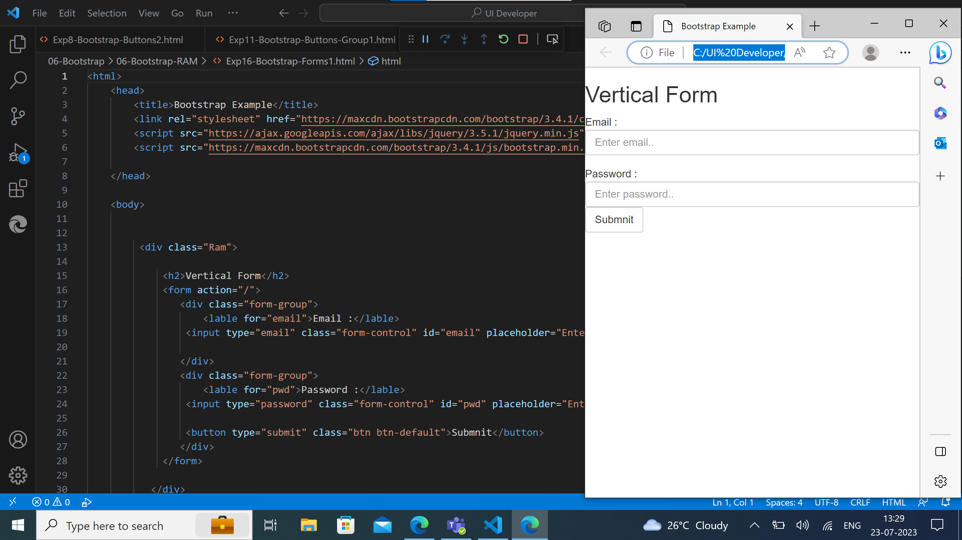

Slide 10
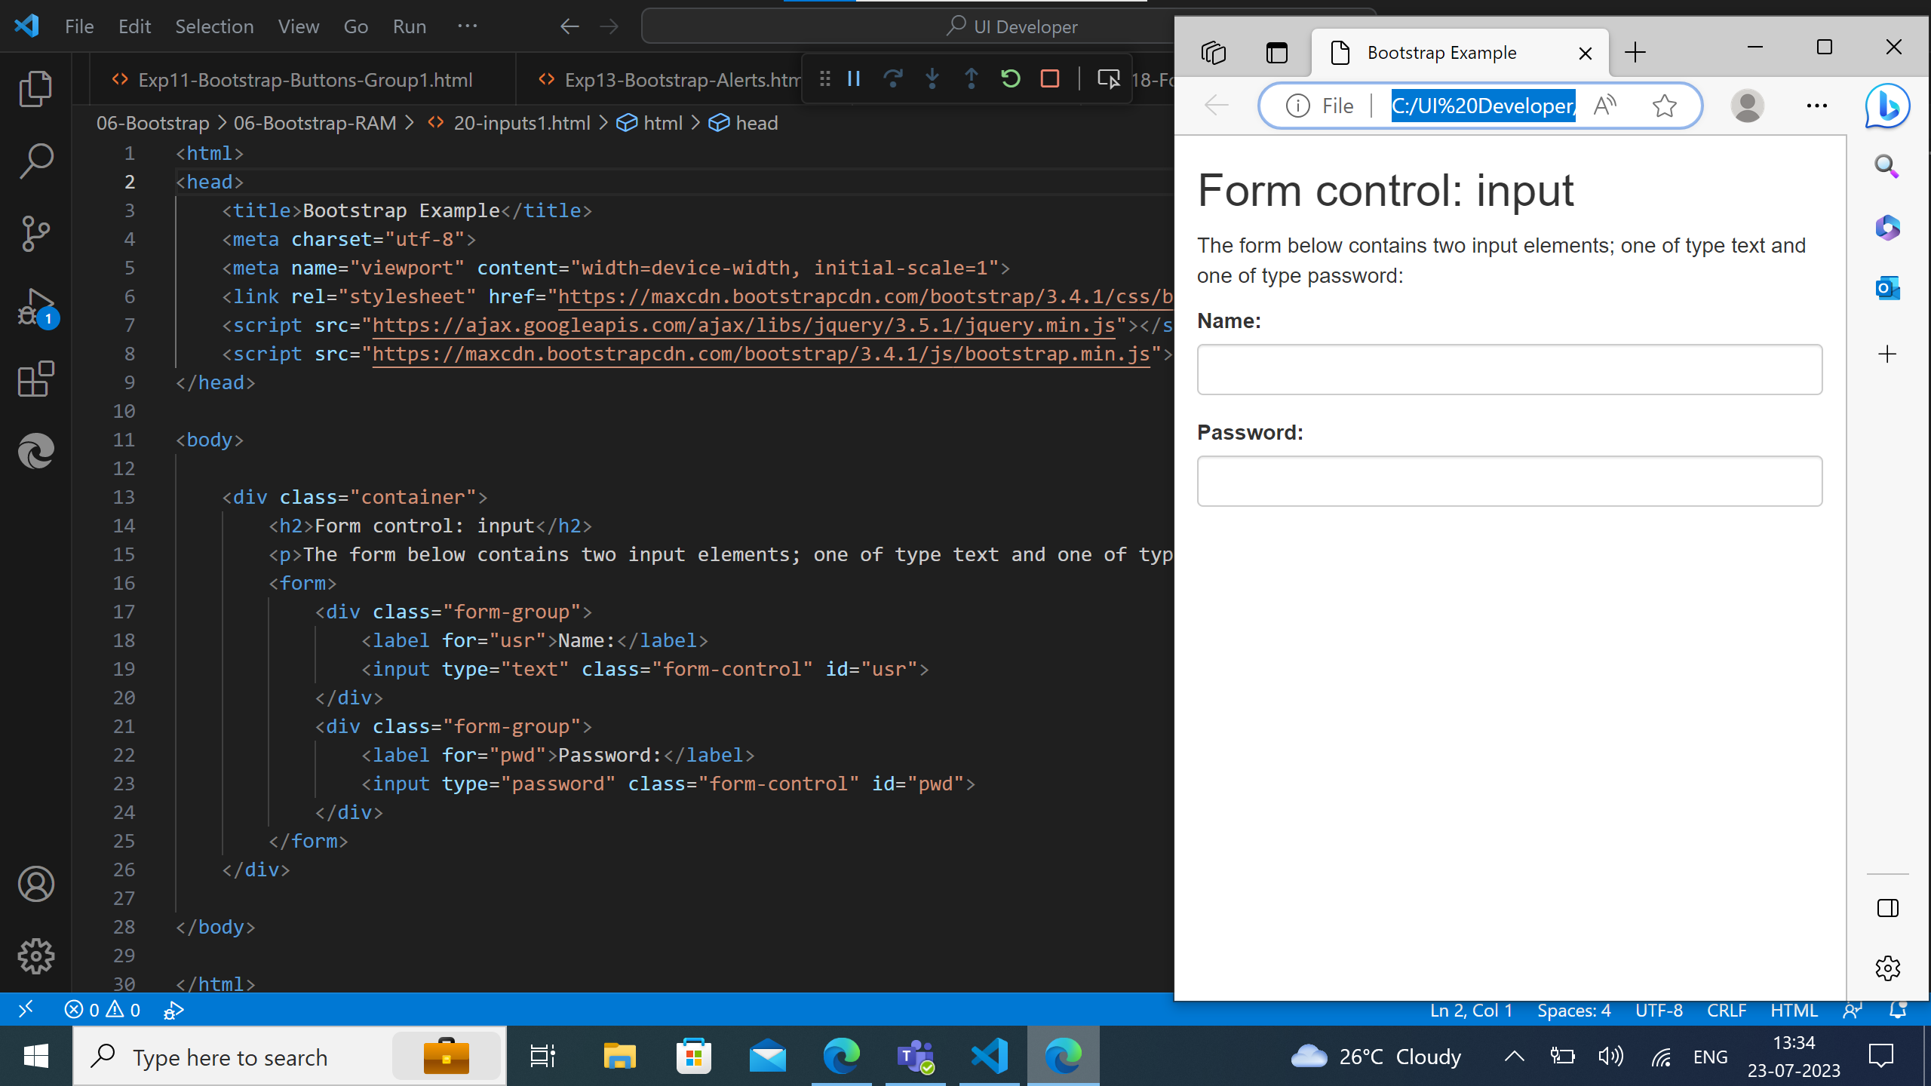

Slide 11


Slide 13


Slide 14
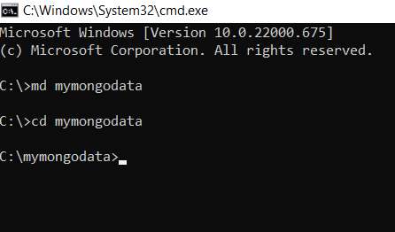
MongoDB Installation:
It is a source-available cross platform document oriented database program.

Slide 15


Slide 16
MongoDB(NoSQL)
MongoDB is a non-relational document database that provides support for JSON like storage.
The MongoDB database has a flexible data model that enables you to store unstructured data, and it provides fill indexing support , and replication with rich and intuitive APIs.
MongoDB commands:
With RDBMS we have Databases, Tables ,rows and columns, But in NoSQL databases, such as MongoDB, data stored in BSON(a binary version of JSON).They are stored in structures called collections.

Slide 17
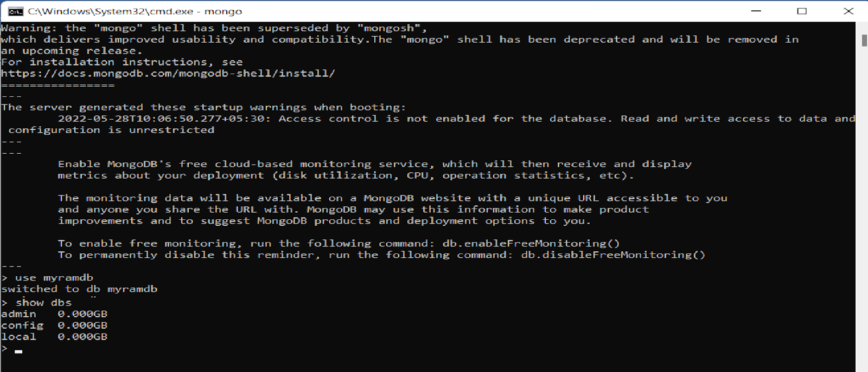
MongoDB command prompt:

Slide 18
MANGO DB TAGS
#creating the product name price and product id
> db.product.insert({"product1":"cargopants","price":2500})
WriteResult({ "nInserted" : 1 })
> db.product.insert({"product2":"denim pants","price":1500})
WriteResult({ "nInserted" : 1 })
> db.product.insert({"product3":"denimshirts","price":3500})
WriteResult({ "nInserted" : 1 })
> db.product.insert({"product4":"hoddies","price":3500})
WriteResult({ "nInserted" : 1 })
> db.product.insert({"product5":"tshirts","price":300})
WriteResult({ "nInserted" : 1 })
> db.product.insert({"product6":"shirts","price":1300})
WriteResult({ "nInserted" : 1 })

Slide 19
Finding the data with we are asigned
> db.product.find().pretty()
{
"_id" : ObjectId("64b7d34e8b427ee2722f48c2"),
"product1" : "cargopants",
"price" : 2500
}
{
"_id" : ObjectId("64b7d3ab8b427ee2722f48c3"),
"product2" : "denim pants",
"price" : 1500
}
{

Slide 20
{
"_id" : ObjectId("64b7d3da8b427ee2722f48c4"),
"product3" : "denimshirts",
"price" : 3500
}
{
"_id" : ObjectId("64b7d4108b427ee2722f48c5"),
"product4" : "hoddies",
"price" : 3500
}
{
"_id" : ObjectId("64b7d4758b427ee2722f48c6"),
"product5" : "tshirts",
"price" : 300

Slide 21
Checking wheather the It is deleted are not by finding the database
> db.product.find({})
{ "_id" : ObjectId("64b7d34e8b427ee2722f48c2"), "product1" : "cargopants", "price" : 2500 }
{ "_id" : ObjectId("64b7d3da8b427ee2722f48c4"), "product3" : "denimshirts", "price" : 3500 }
{ "_id" : ObjectId("64b7d4108b427ee2722f48c5"), "product4" : "hoddies", "price" : 3500 }
{ "_id" : ObjectId("64b7d4758b427ee2722f48c6"), "product5" : "tshirts", "price" : 300 }
{ "_id" : ObjectId("64b7d4a08b427ee2722f48c7"), "product6" : "shirts", "price" : 1300 }

Slide 22
sorting the given data
> db.product.find().sort({"product1":1})
{ "_id" : ObjectId("64b7d3ab8b427ee2722f48c3"), "product2" : "denim pants", "price" : 1500 }
{ "_id" : ObjectId("64b7d3da8b427ee2722f48c4"), "product3" : "denimshirts", "price" : 3500 }
{ "_id" : ObjectId("64b7d4108b427ee2722f48c5"), "product4" : "hoddies", "price" : 3500 }
{ "_id" : ObjectId("64b7d4758b427ee2722f48c6"), "product5" : "tshirts", "price" : 300 }
{ "_id" : ObjectId("64b7d4a08b427ee2722f48c7"), "product6" : "shirts", "price" : 1300 }
{ "_id" : ObjectId("64b7d34e8b427ee2722f48c2"), "product1" : "cargopants", "price" : 2500 }

Slide 23
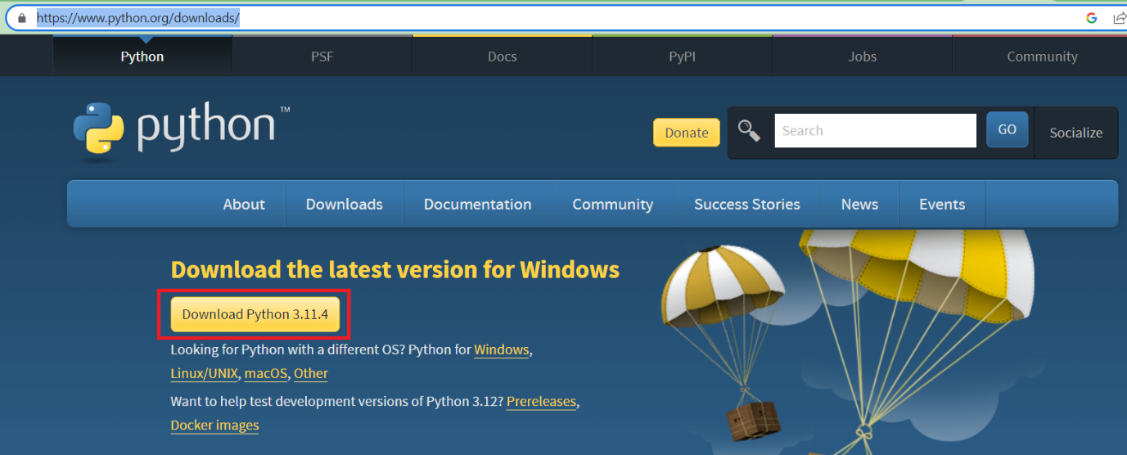
Installation on Python and PyCharm:

Slide 24


Slide 25
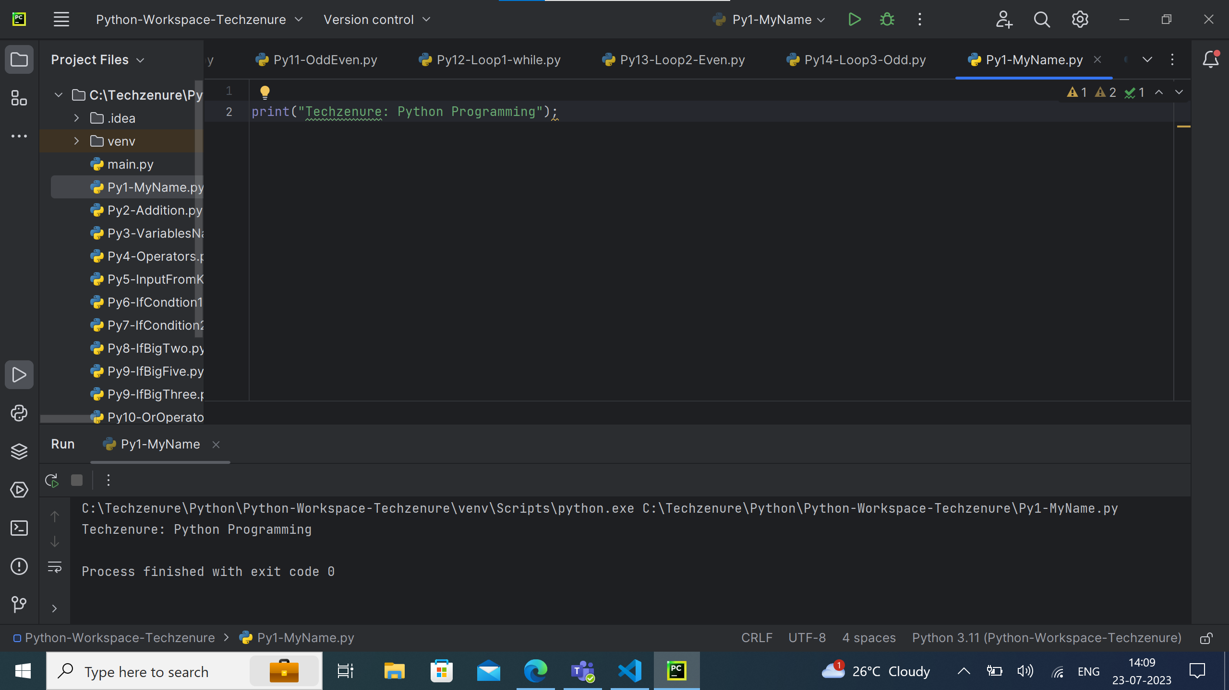

Slide 26
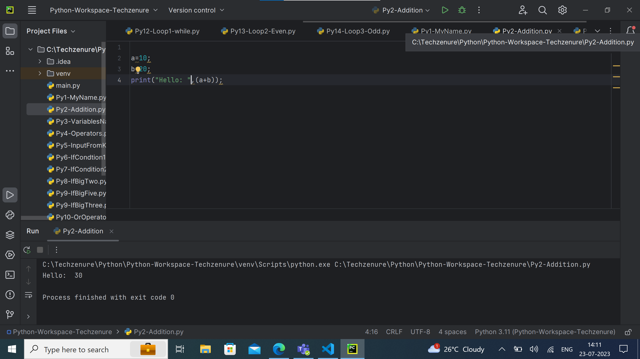

Slide 27
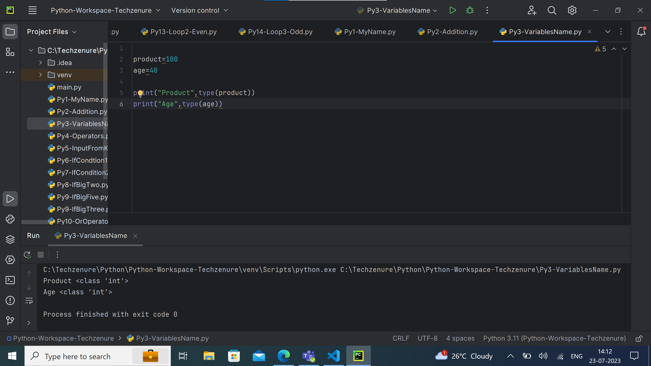

Slide 28
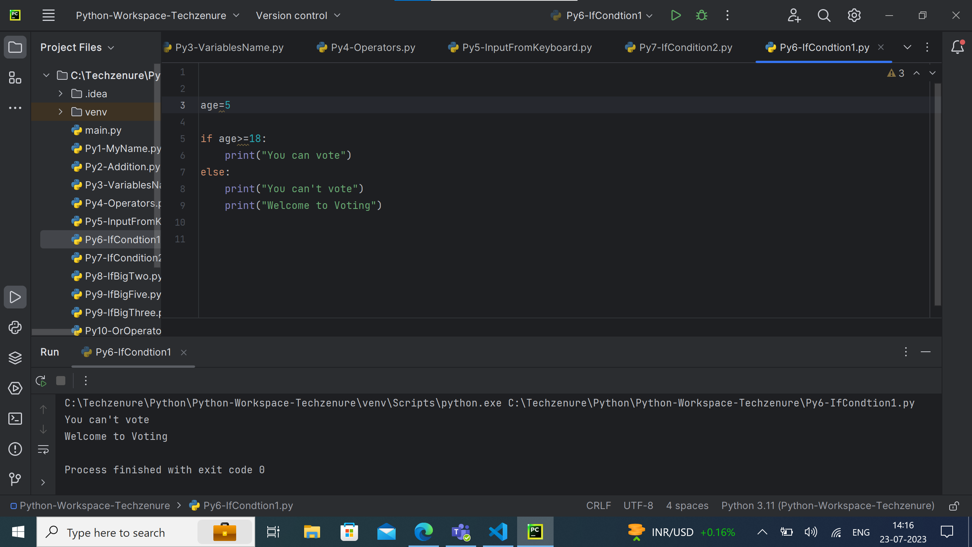

Slide 29
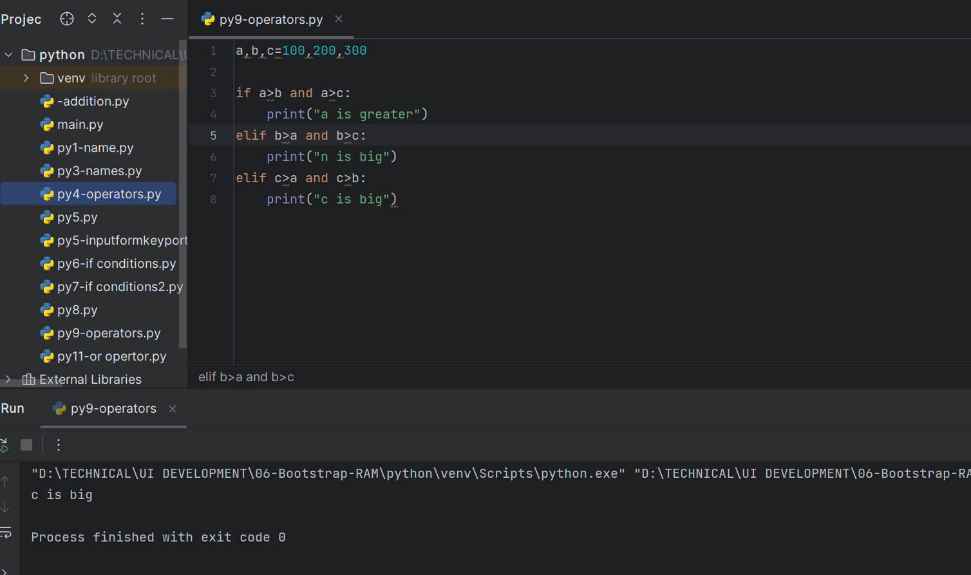
Python codes: USING OPERATORS FINDING GREATEST NUMBERS

Slide 30
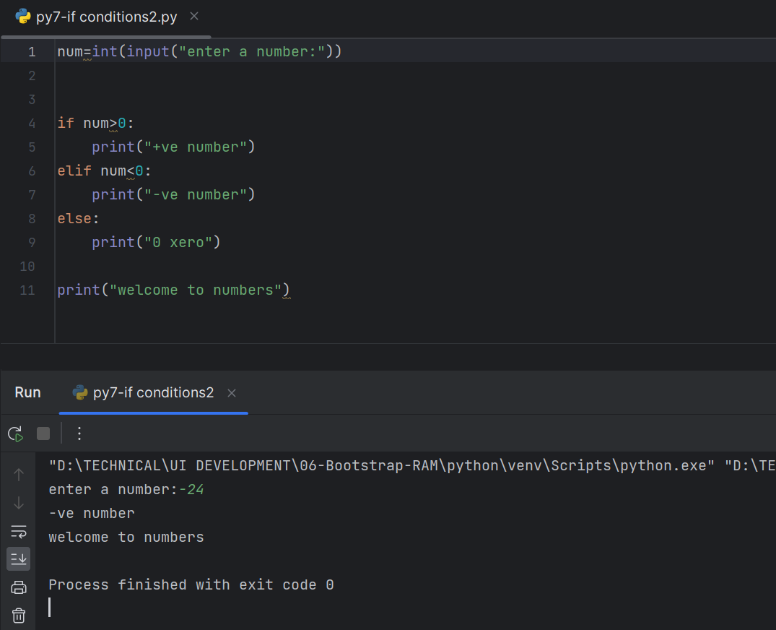
POSITIVE OR NEGATIVE NUMBERS IN PHYHON

Slide 31
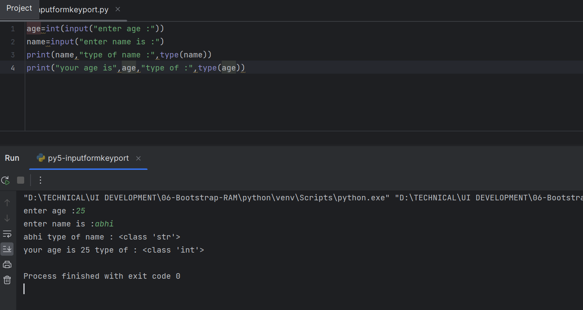
INPUT FORM KEYPORT IN PHYTHON

Slide 32
